Slide 1
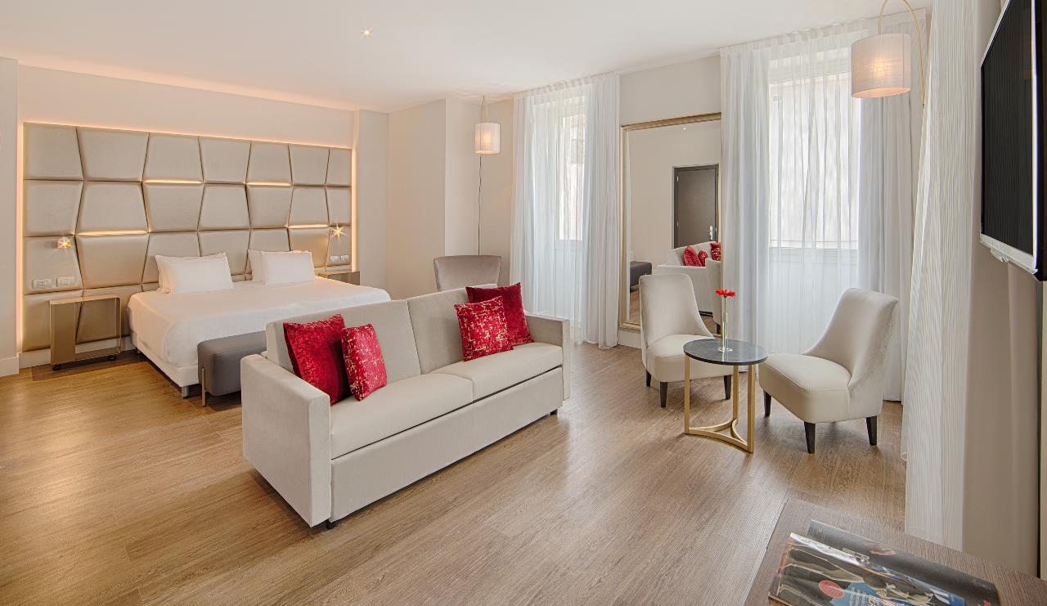
NH Collection Roma Centro

Slide 2
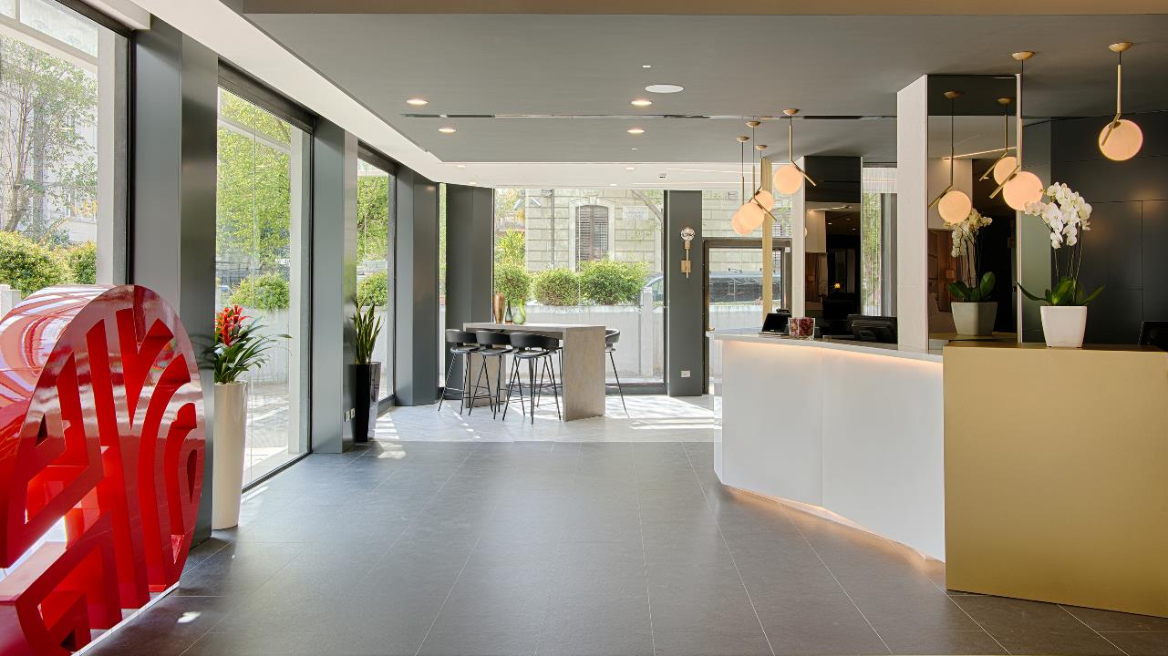
A pleasant and warm welcome

Slide 3
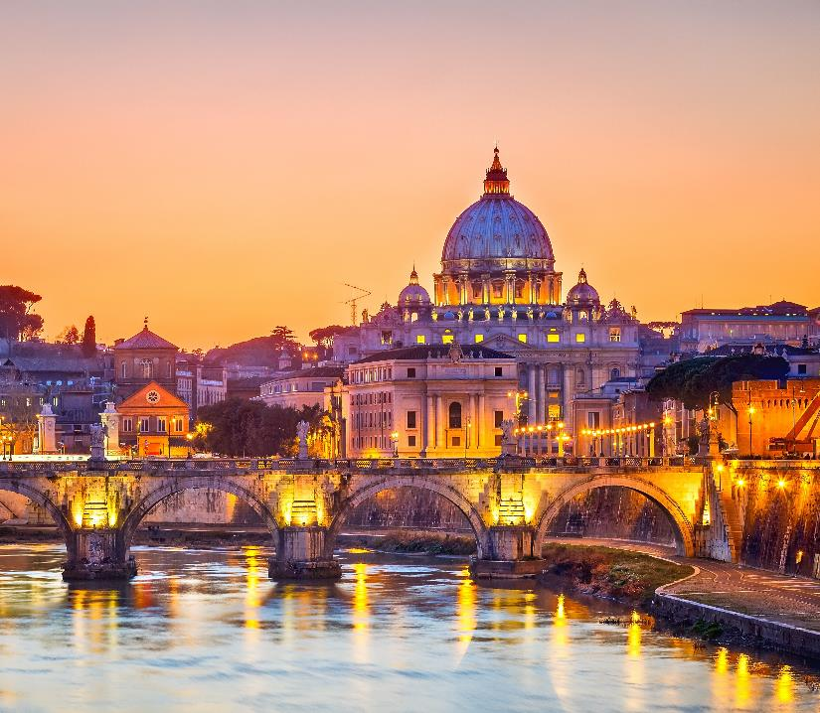
Destination and location
NH Collection Roma Centro is situated in an
excellent position in the heart of Rome in the
elegant Rione Prati district, a renowned centrally located residential area.
The location is strategic either for business and leisure travelers, close to the main historical sites as well as to the sophisticated boutiques of Cola di Rienzo street where you can discover style and elegance of the main Italian and international fashion designers.
Vatican City
Castel Sant’Angelo
Piazza del Popolo

Slide 4
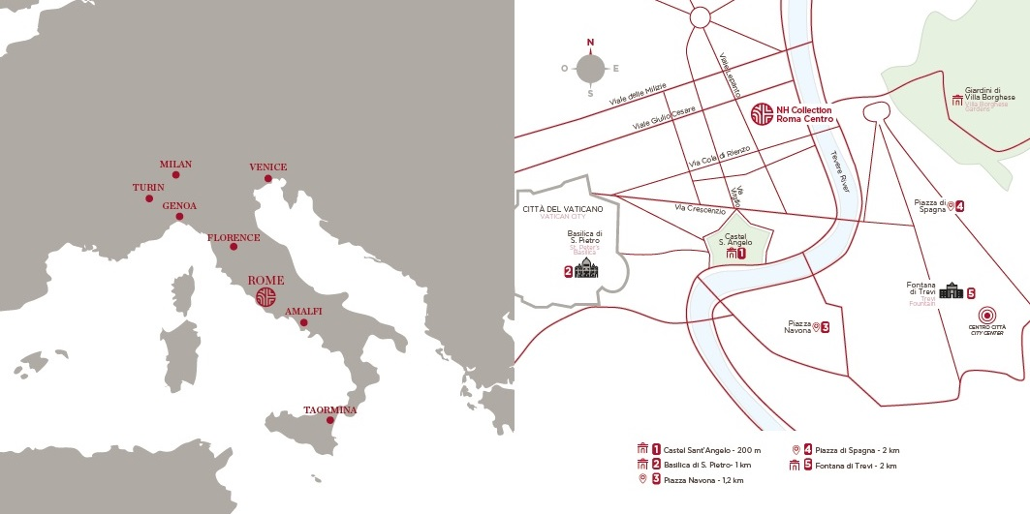

Slide 6
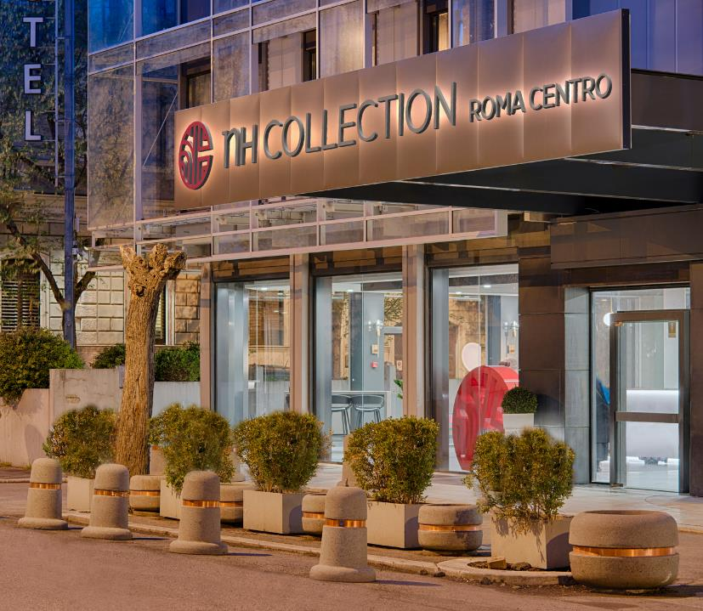
Hotel History
NH Collection Roma Centro has a distinctive
architectural style that perfectly blends with the
prestigious atmosphere of the district where it is located: glass and alluminium curtain walls with particular dedication to the interior design.
Stylish and modern spaces without compromising comfort and elegance
Perfect union between tradition and creativity
Breathtaking views of Rome's historical architecture and skyline from the upper floors

Slide 7
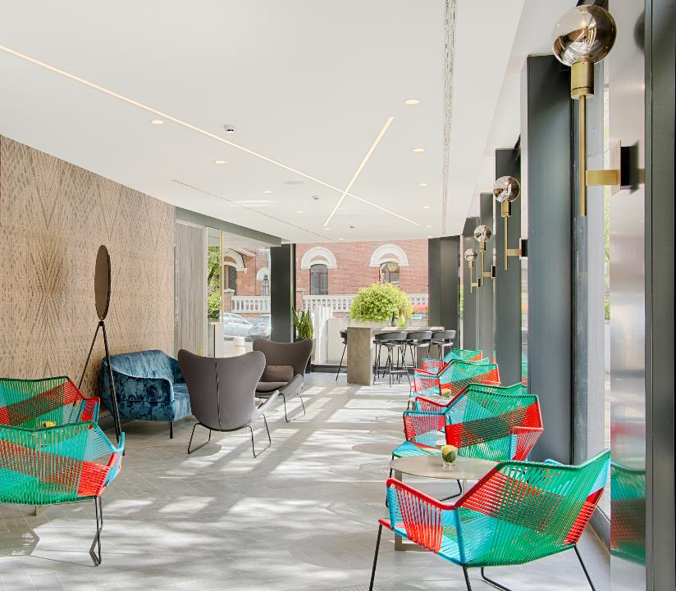
Interior Design & Settings
The NH Collection Roma Centro, formerly known as NH Roma Leonardo da Vinci, has undergone a sophisticated refurbishment.
An imposing building characterized by a second crystal skin and an innovatory interior decoration is now a new generation hotel.
Refined modern style
Chic atmosphere combined with
contemporary taste
Charm and elegance design

Slide 8
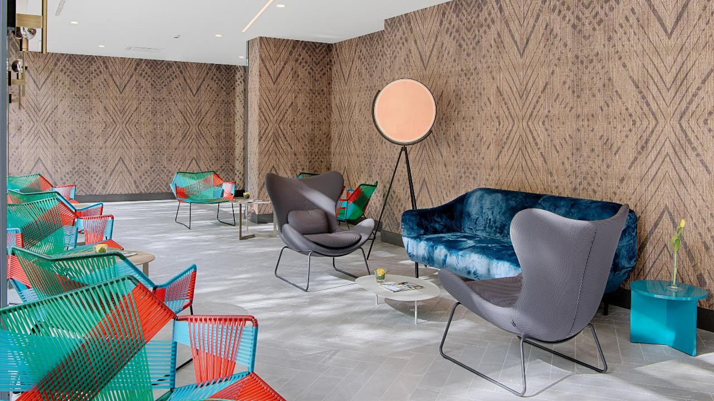
An elegant and welcoming location

Slide 10
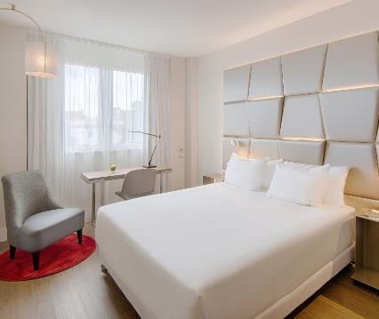
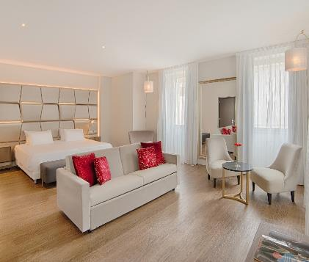
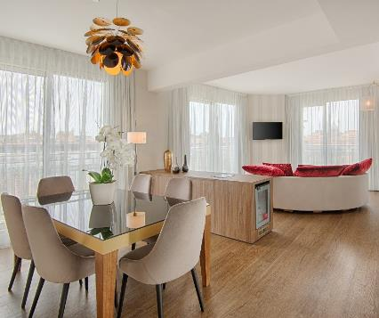
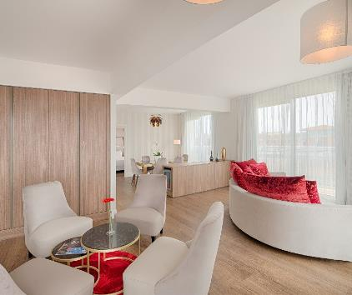
Accommodation
The hotel has 257 modern and spacious rooms, distributed over 8 floors.
Rooms located on the upper floors offer to our guests a panoramic views of Rome's beautiful and historical architecture and skyline including St Peter’s Dome.
149 Superior Rooms
79 Premium Rooms
18 Premium Rooms with view
7 Premium XL Rooms
8 Junior Suites
5 Duplex Suites with view
1 Presidential Suites with view

Slide 11
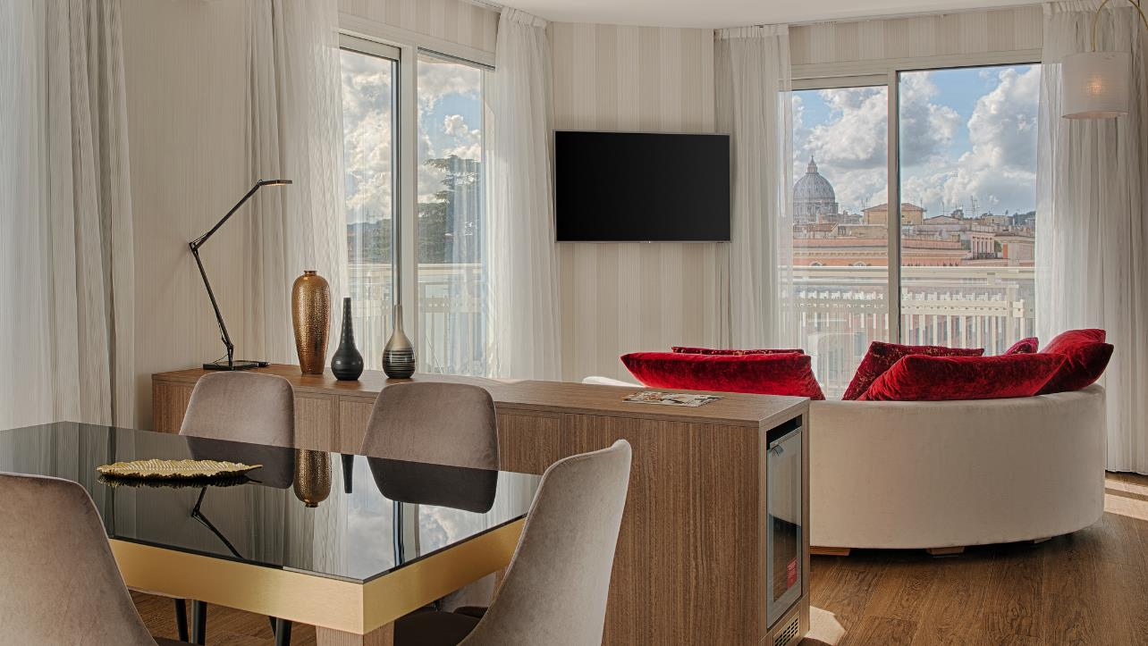
Enjoy the breathtaking view from the Presidential Suite

Slide 12
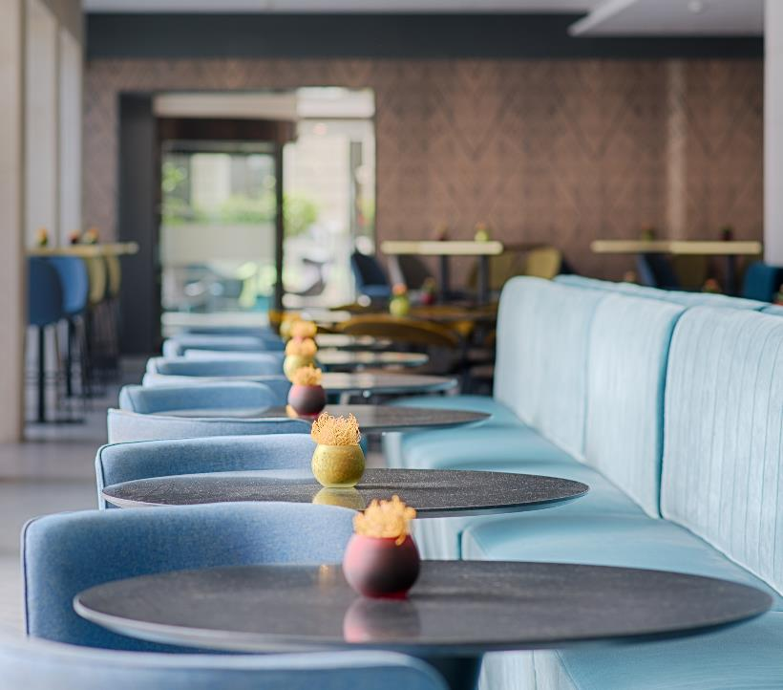
Services: Gastronomy
The restaurant at NH Collection Roma Centro provides a varied high-quality culinary experience that will surprise you with refined specialties of Italian and international cuisine as well as flavours of traditional Rome dishes.
Our guests may choose their preferred wine from a wide selection or decide to taste new labels from local wineries.
Refined and traditional Roman cuisine
Great list of Italian wines
Delicious and healthy breakfast every morning

Slide 13
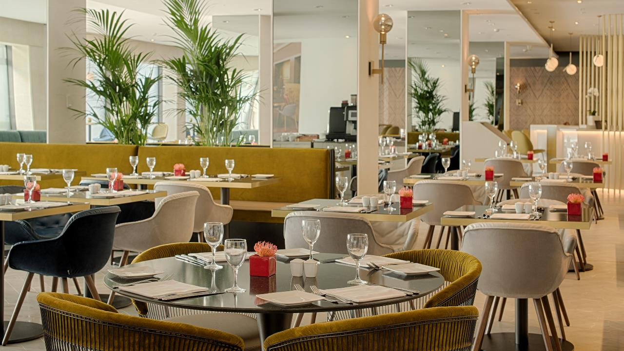
A space to enjoy the typical Italian cuisine

Slide 14
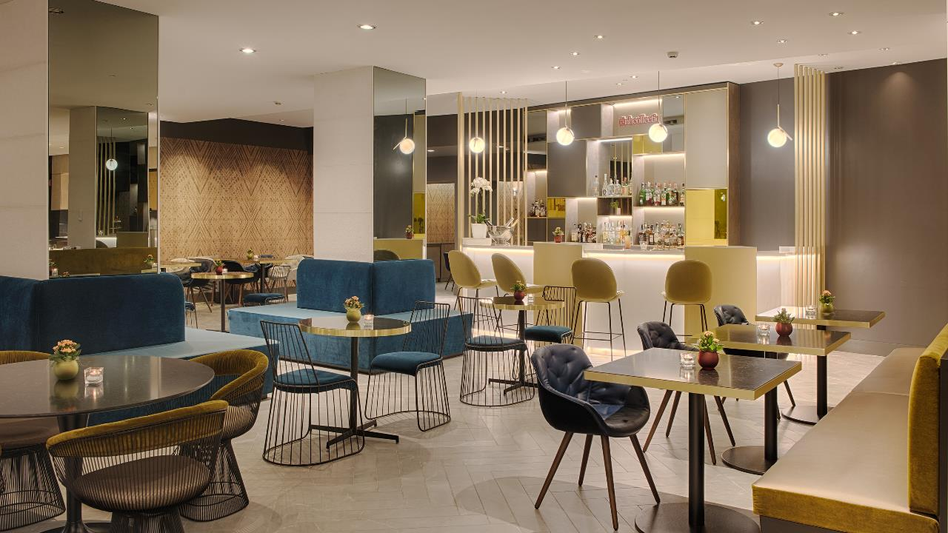
A stylish and contemporary bar to indulge and socialize

Slide 15
Meetings & Events
The hotel NH Collection Roma Centro offers you high level of comfort and technology for successful conferences, meetings and events.
Nineteen meeting rooms extremely functional provide versatile spaces for hosting meetings up to a maximum of 220 delegates.
Three plenaries and several break out rooms are ready to meet any kind of request whilst our specialized staff is at our guests complete disposal to take care of any need.

Slide 16
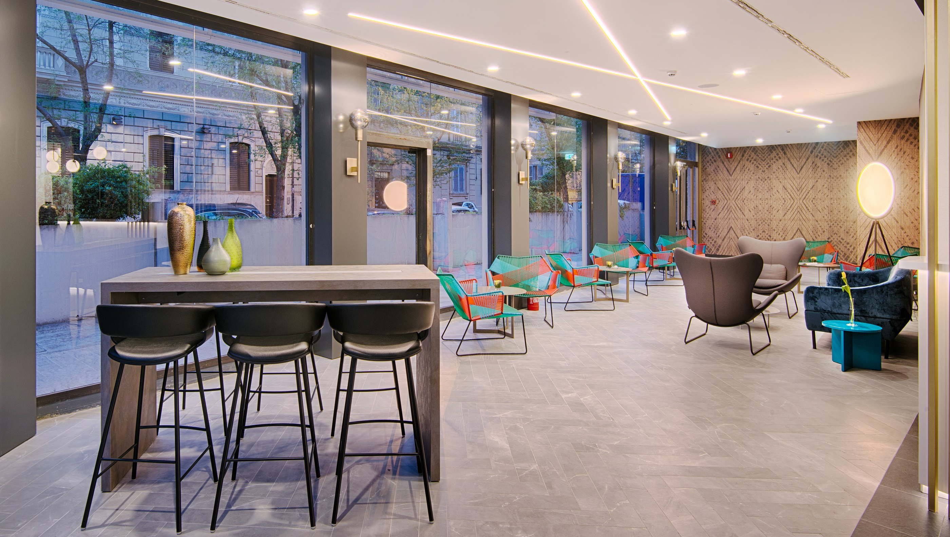
A stroll through the eternal city
The new place to be in Rome

Slide 17
About NH
The NH Collection, the upper-upscal brand of the NH Hotel Group, has hotels located in the main cities of Europe and Latin America. Its distinctive and authentic buildings maintain their local character, being a source of inspiration for guests who expect to feel something more. The attention to detail and the little unexpected gestures turn the experience into something extraordinary.

Slide 18
Feel the place connecting with the city’s soul.
Feel inspired by the eclectic elegant atmosphere.
Feel unique rejoicing in outstanding service.
Get ready to feel.

